Slide 1
Community Detection Service on Cytoscape
09/10/19

Slide 2
Motivation
Current community detection algorithms/ services:
Long/ user-unfriendly documentation
Not readily portable for a pipeline of usage: graph -> CD -> visualization -> labeling
Our goal:
Build community detection services for popular algorithms that can be easily called by Cytoscape & other apps
Develop user-friendly CD menus & tools on Cytoscape which have interfaces to CD services, NDEx, gProfiler...

Slide 3
The solution +
Write a Cytoscape app that calls community detection algorithms encapsulated in Docker images
Problem: Not everyone can run Docker (Windows 10 home)
Solution: Create a REST service for the app to call

Slide 4
What is Docker?
“A tool designed to make it easier to create, deploy, and run applications by using Containers”
-- https://opensource.com/resources/what-docker
Notes:
https://www.datadoghq.com/docker-adoption/
https://www.datanyze.com/market-share/containerization/docker-market-share

Slide 5
What is a Container?
“A Docker Container Image is a lightweight, standalone, executable package of software that includes everything needed to run an application: code, runtime, system tools, system libraries and settings.
Container Images become Containers at runtime”
-- https://www.docker.com/resources/what-container

Slide 6
What does all that mean?
Lets one package/bundle an application in any language and run “anywhere”
“anywhere” Docker can be installed
(Mac, Linux, Windows)
Notes:
https://stackoverflow.com/questions/16047306/how-is-docker-different-from-a-virtual-machine

Slide 7
What is a REST Service?
“REST is an acronym for REpresentational State Transfer. It is architectural style for distributed hypermedia systems and was first presented by Roy Fielding in 2000 in his dissertation.” -- https://restfulapi.net/
Basically it is a website and pattern of use that is designed for computers/software to access.

Slide 8
Why a REST Service?
Easy for web developers to create a website that uses the service
Easy for software developers to use
No installation, no beefy hardware requirements
Accessible from all environments (Windows, Mac, Linux) and most languages
Easy for Cytoscape App developers to use

Slide 9
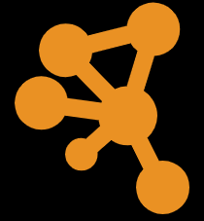
Community Detection Suite
Network Edge List
CD App
CD Services
Gene List
Term Mapping Services
Hierarchy Edge List
GO Result
Gene List
GO Result
Interaction/Hierarchy Network
Adjacency list
CliXo
Louvain
Infomap

Slide 10
Community Detection Services
Louvain
https://louvain-igraph.readthedocs.io/en/latest/index.html
Weight optional
Can detect overlap communities (currently not compatible with detecting deep hierarchy)
Default resolution parameter: 0.1
Original output: community assignment

Slide 11
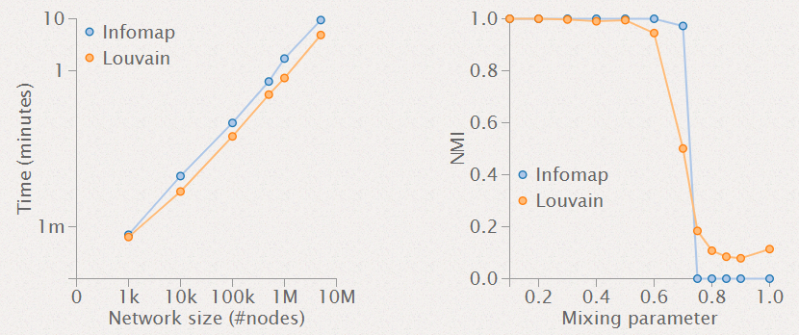
Community Detection Services
Infomap
https://www.mapequation.org/code.html
Hierarchy shallower than louvain, but can have overlapping communities with substantial runtime increase
Universal method applicable to any graph
Default markov-time: 0.75
Original output: tree file

Slide 12
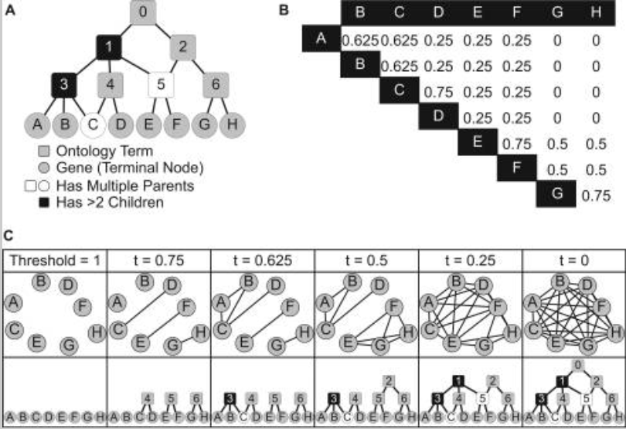
Community Detection Services
CliXO
https://github.com/fanzheng10/CliXO
Popular CD method focusing on clique detection
Work on small and weighted graph
Default alpha: 0.1, beta: 0.5

Slide 13
Community Mapping
gProfiler https://github.com/ndexbio/cdgprofilergenestoterm
Use Gene Ontology(GO)
Return GO term with a list of mapped genes
Each takes 2-3 s; decide to map on sub-hierarchy

Slide 14
Community Detection App for Cytoscape
Java-based plugin for Cytoscape
Encapsulates REST API calls to CD algorithms and term alignment tools
Provides fast communication with CD service by reducing network overhead
Robust hierarchy network data model
Can be easily linked with an interaction network
Provides node table columns for effective styling
Gene list for each community can be directly searched in the original network

Slide 15
Community Detection App for Cytoscape
Network Edge List
CD App
CD Services
Gene List
Term Mapping Services
Hierarchy Edge List
GO Result
Gene List
GO Result
Interaction/Hierarchy Network
Adjacency list
CliXo
Louvain
Infomap

Slide 16
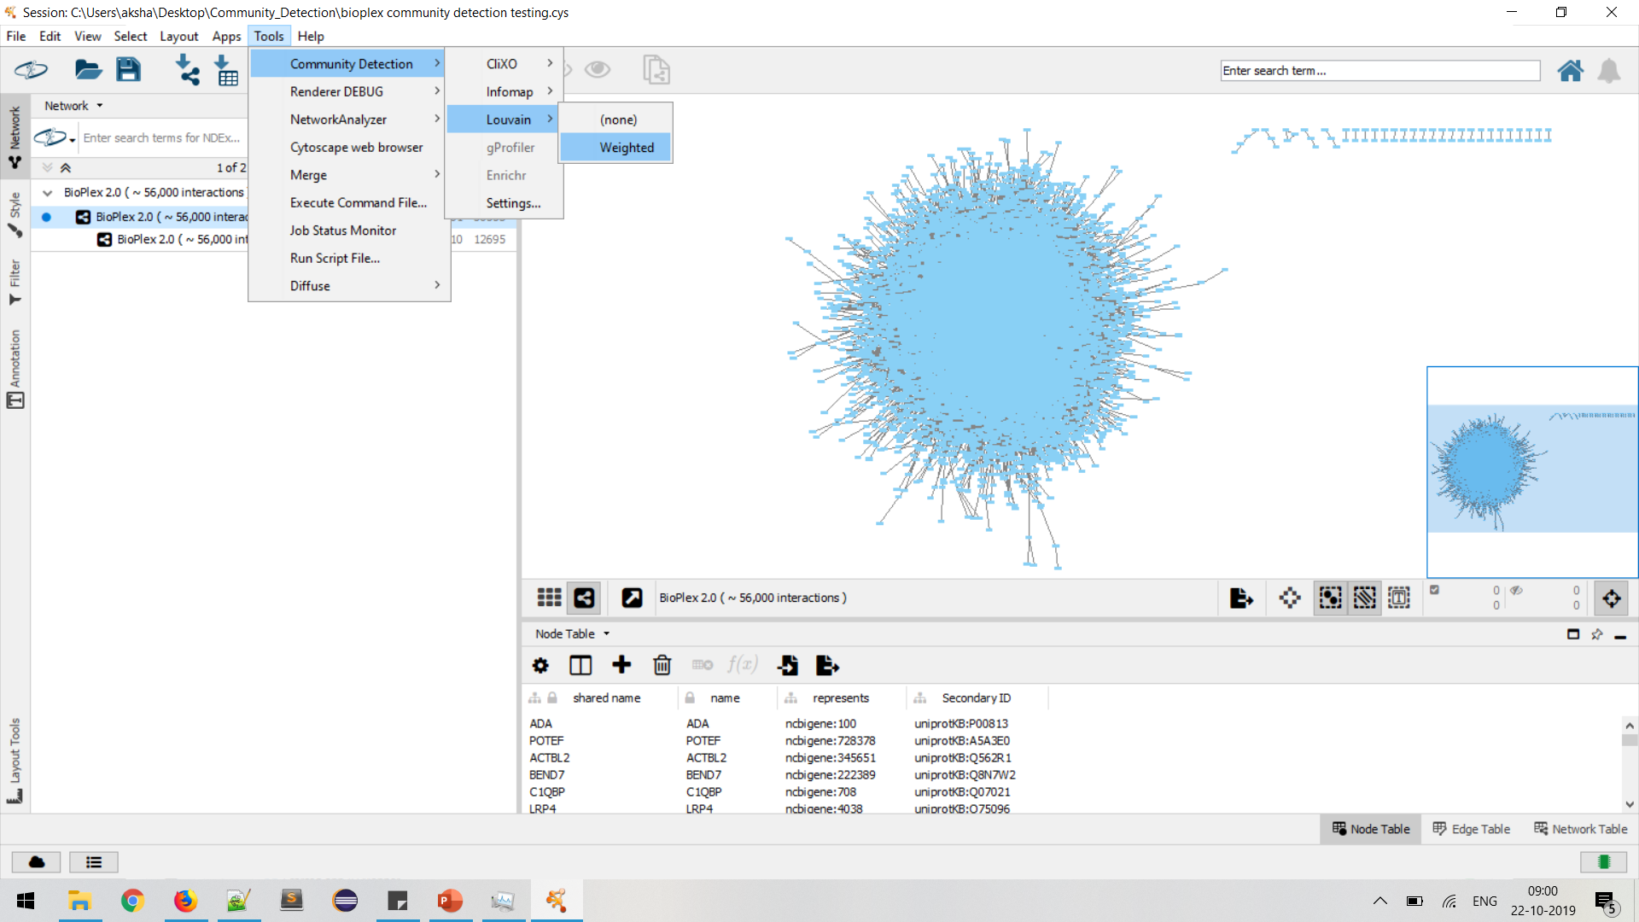

Slide 17
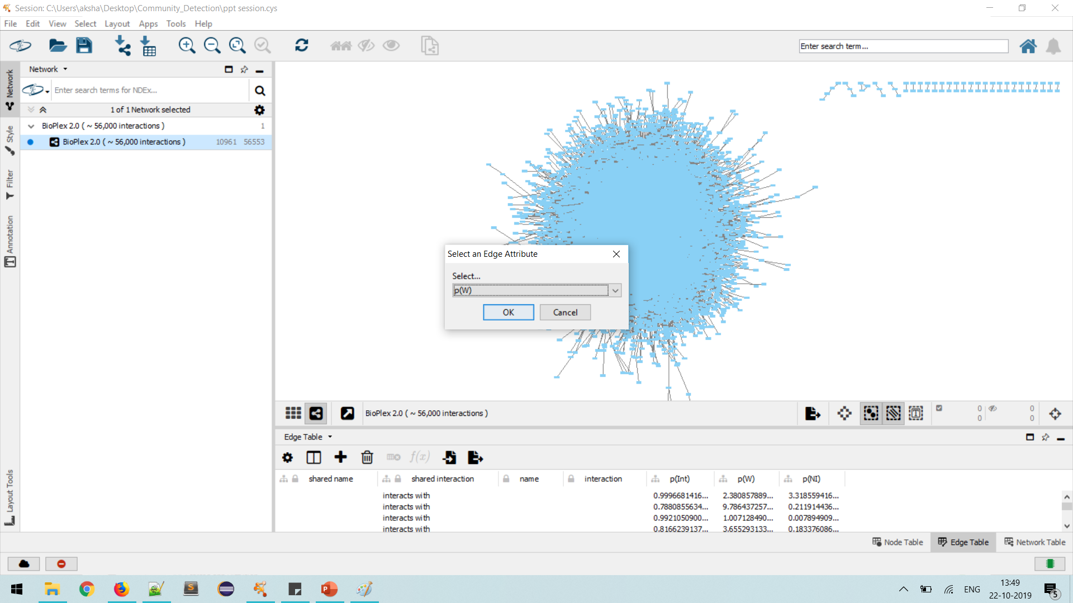

Slide 18
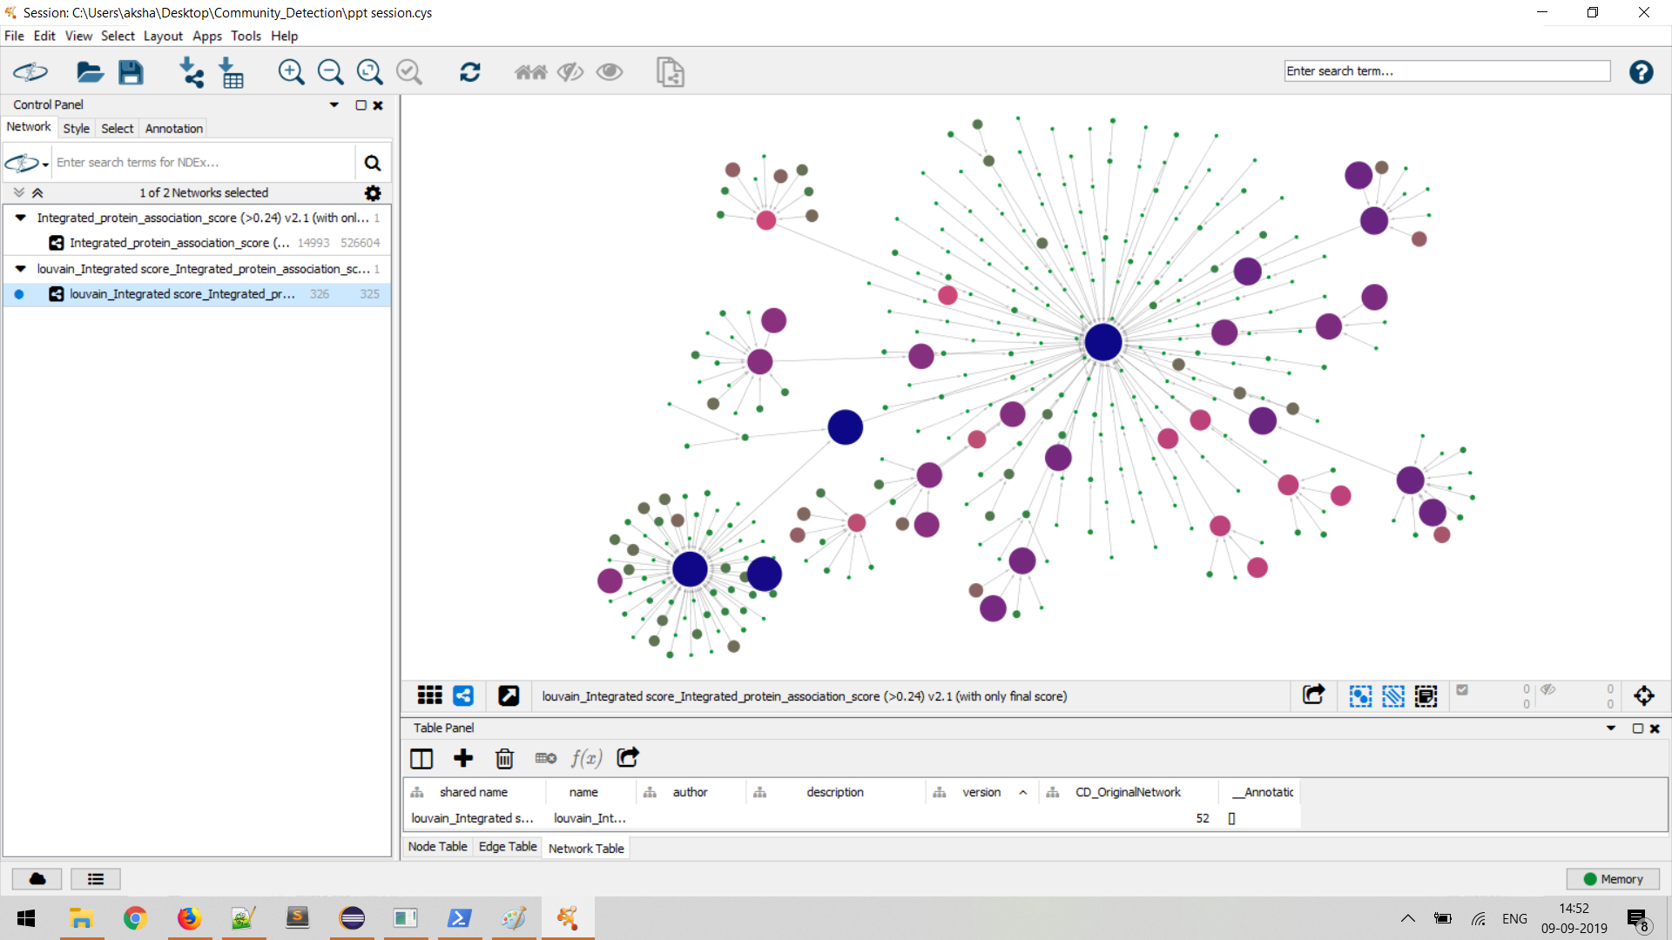

Slide 19
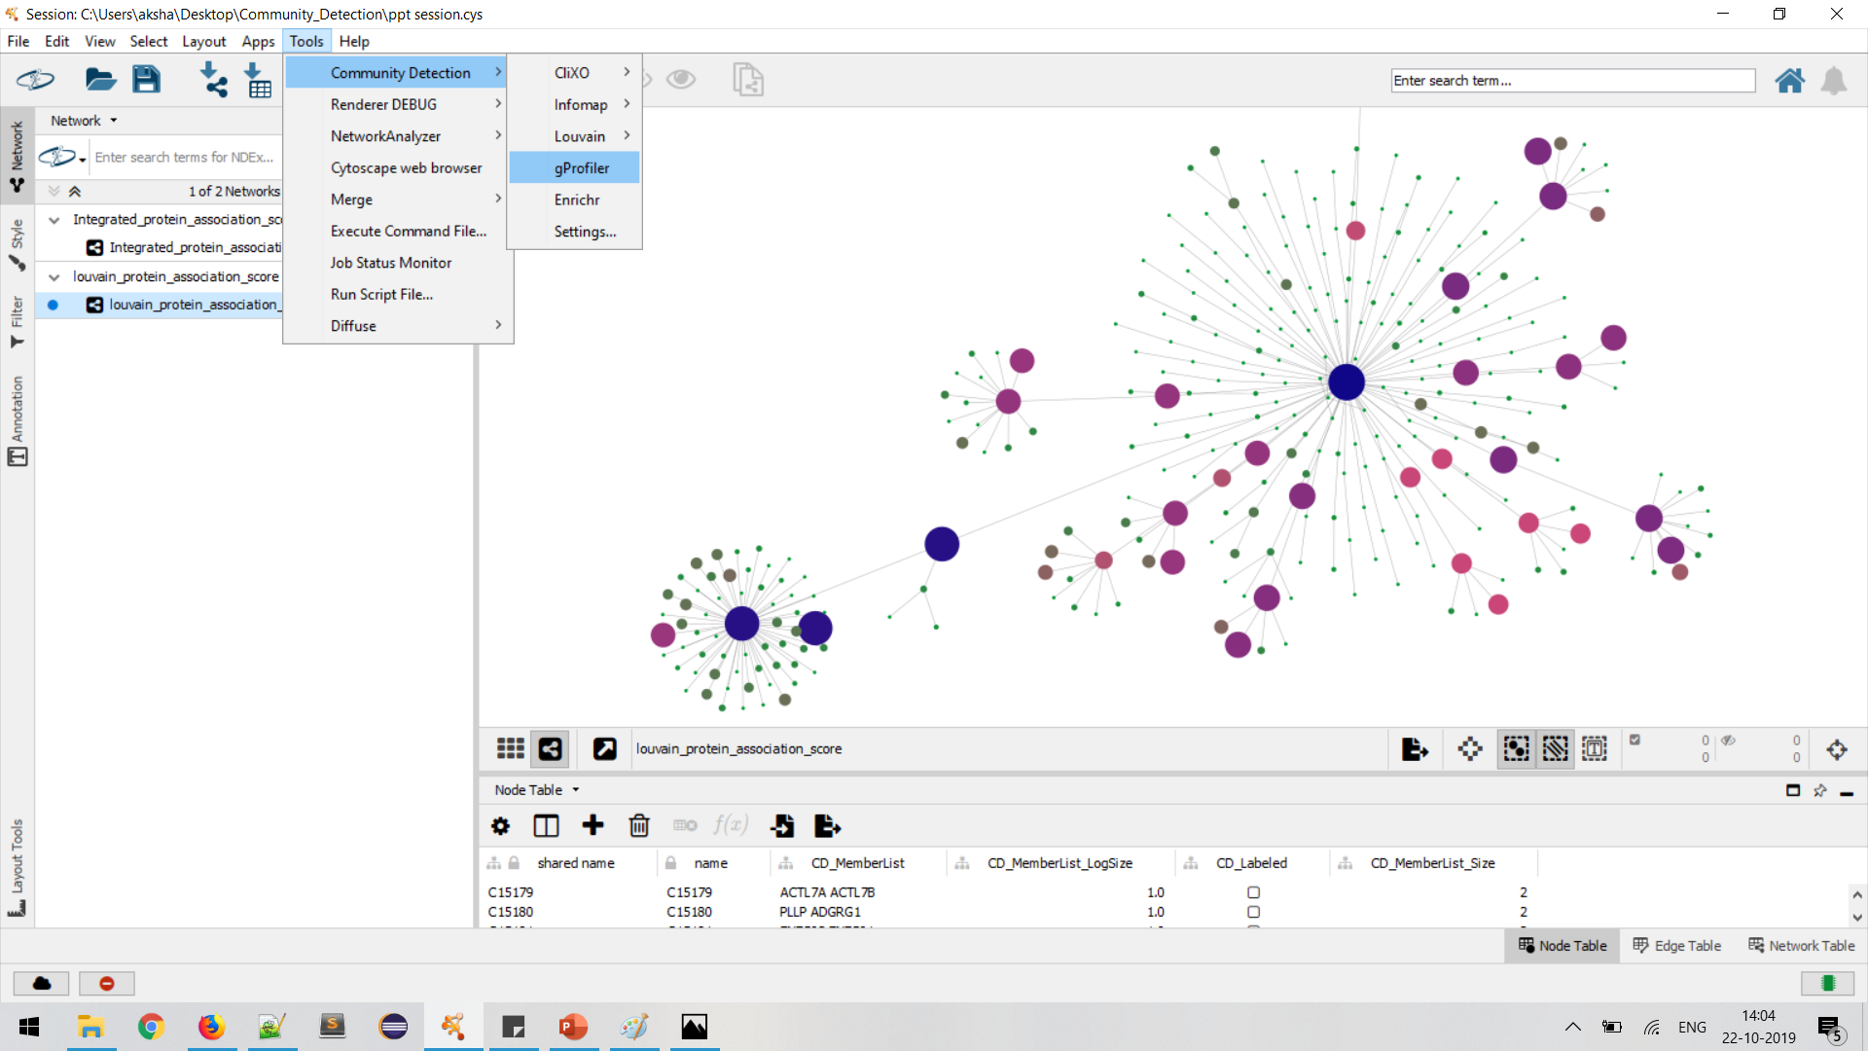

Slide 20
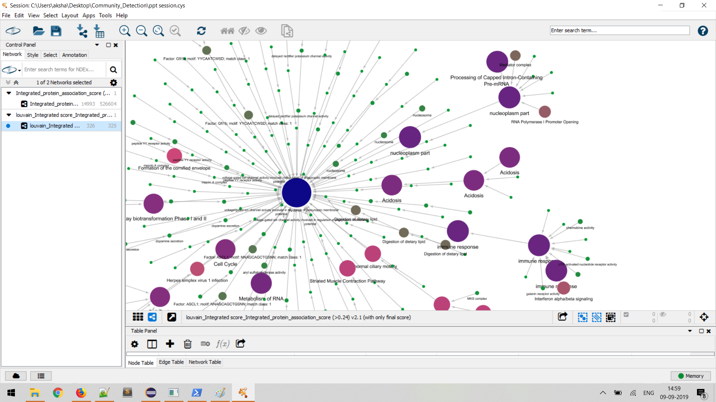

Slide 21
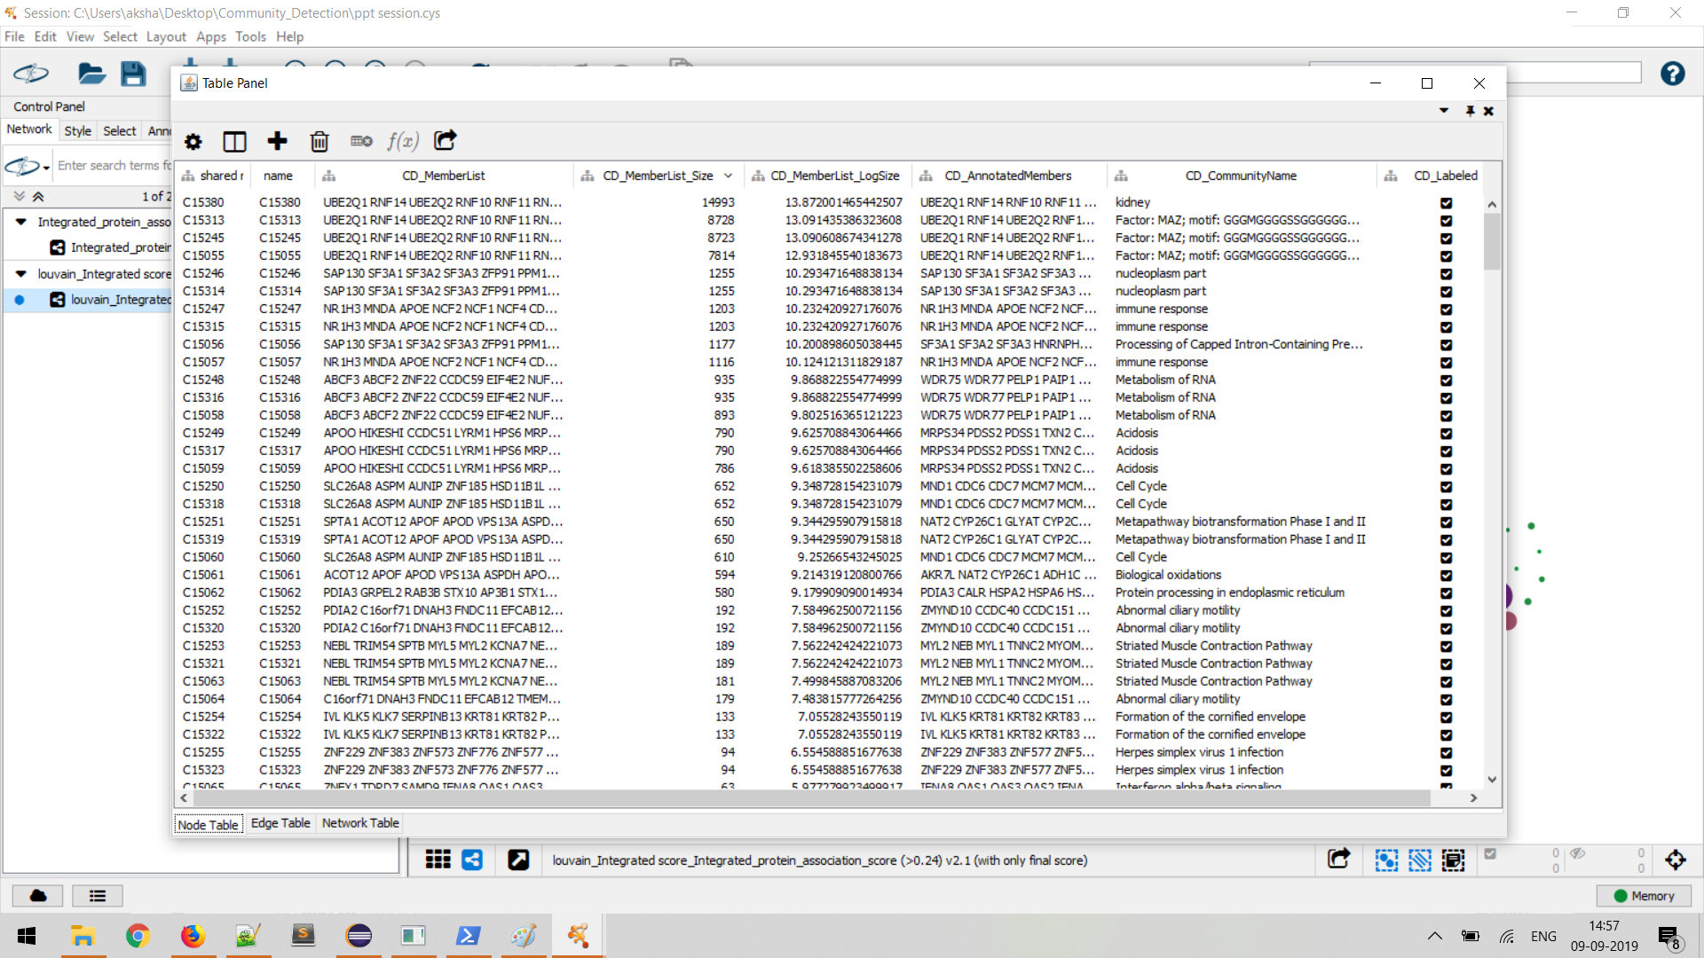

Slide 22
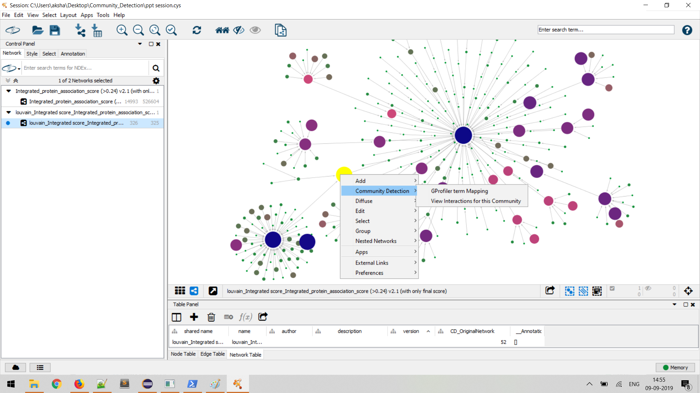
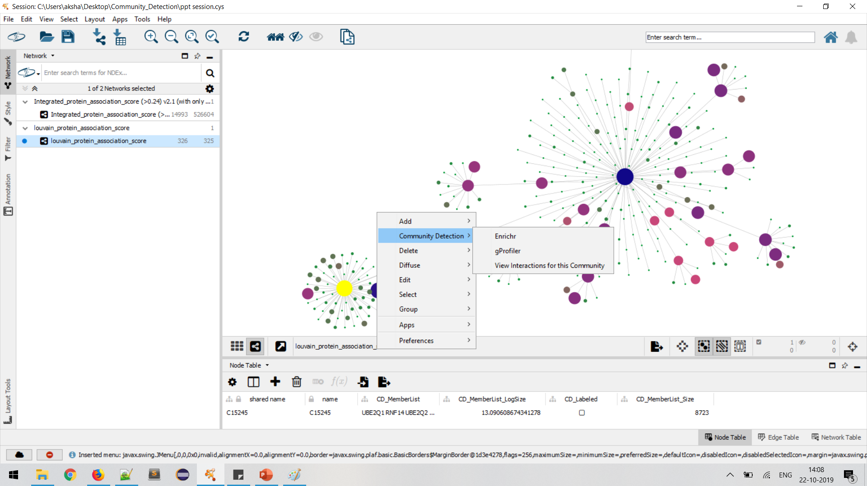

Slide 23
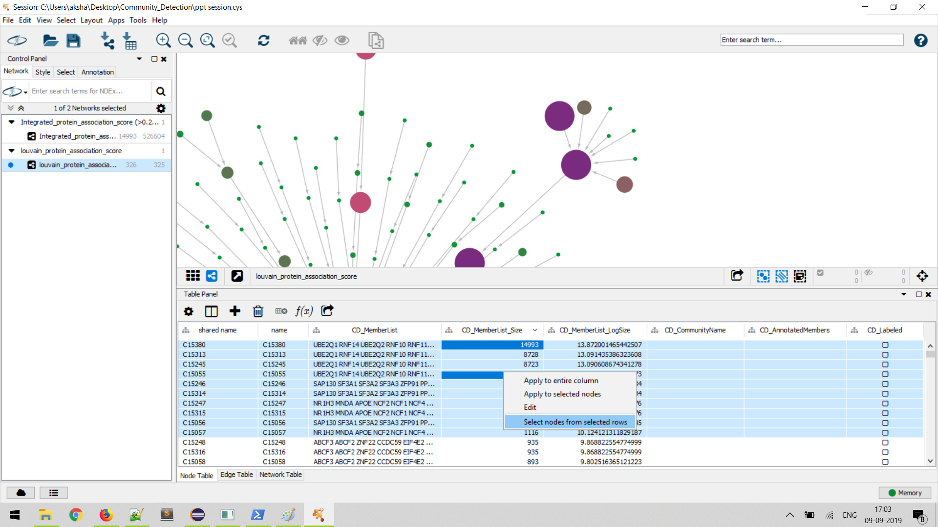

Slide 24
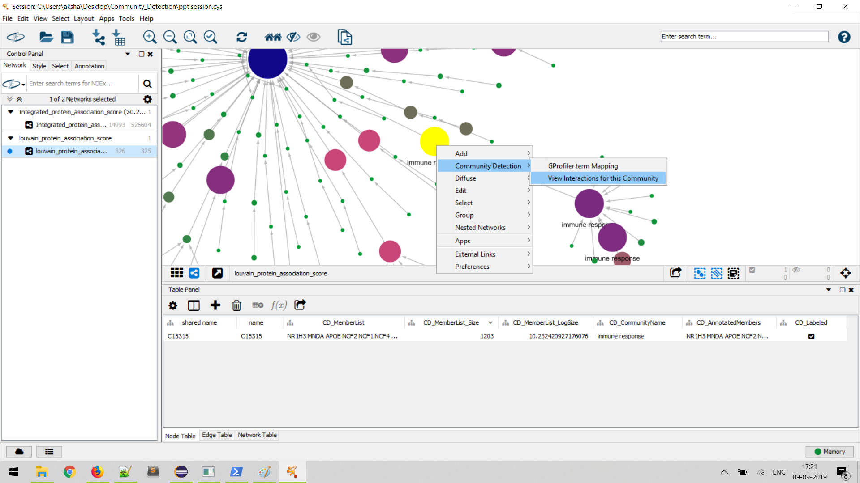
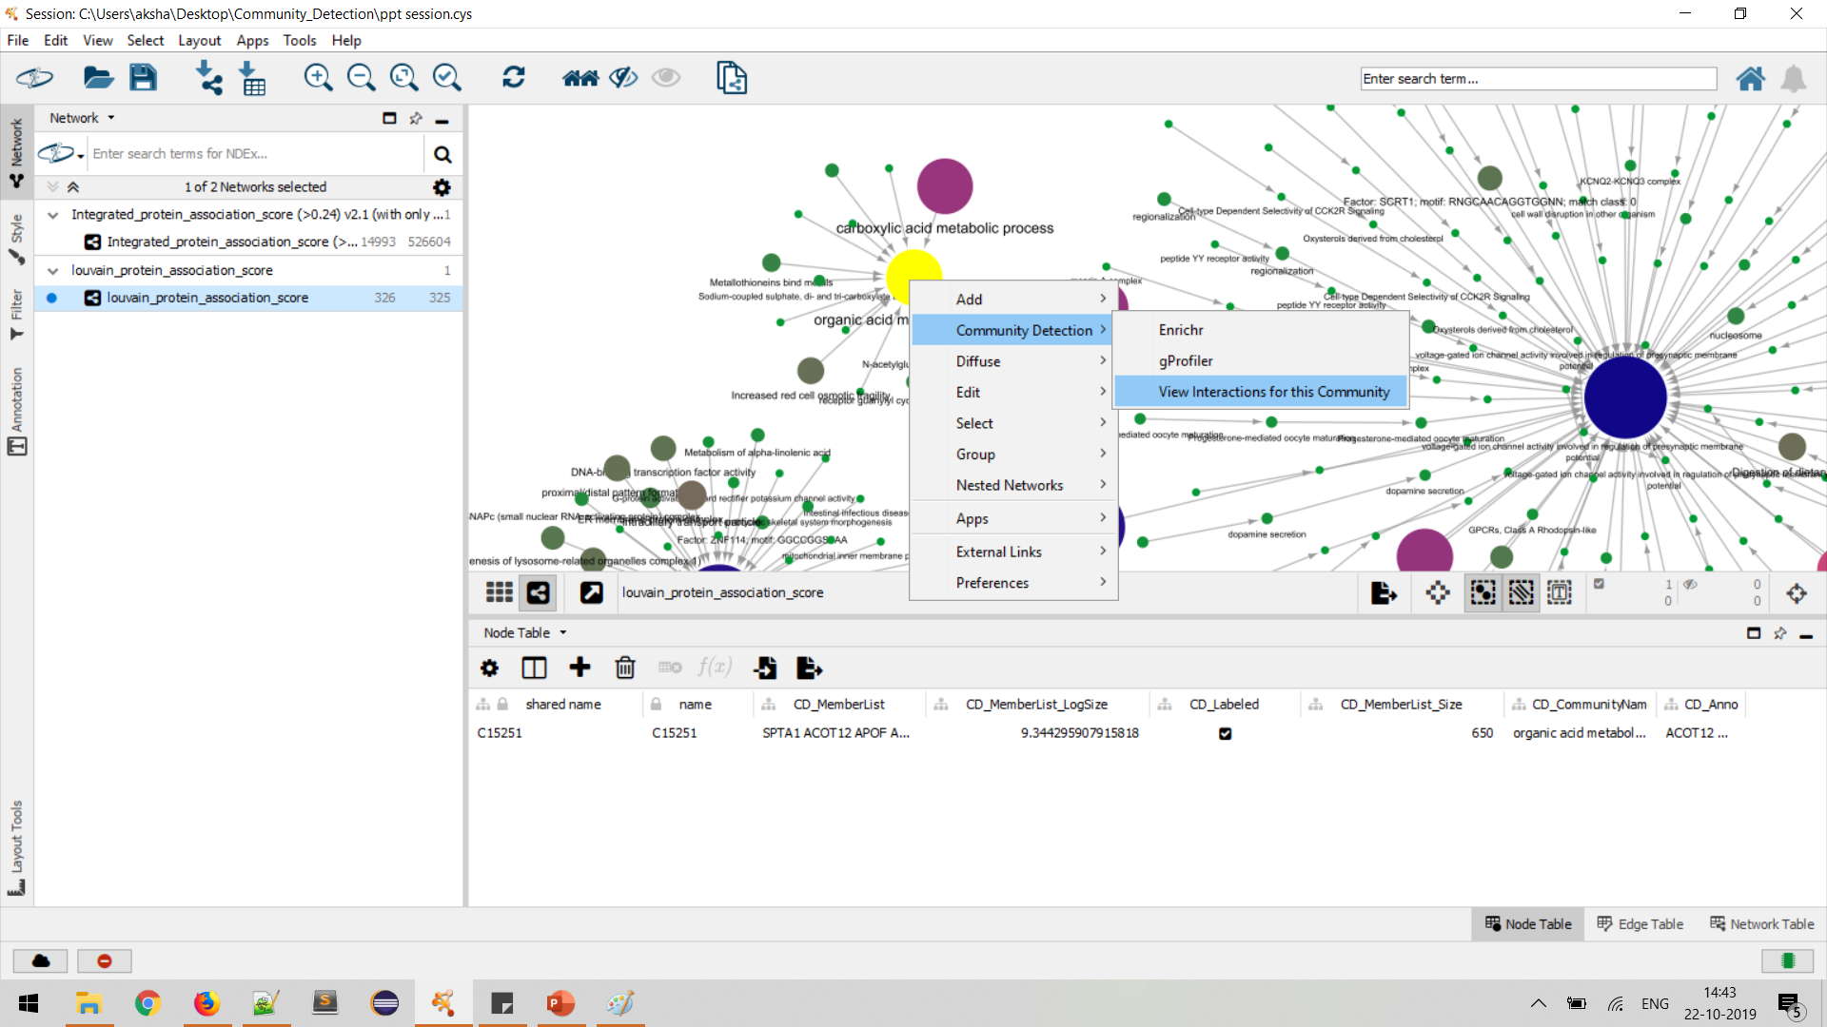

Slide 25
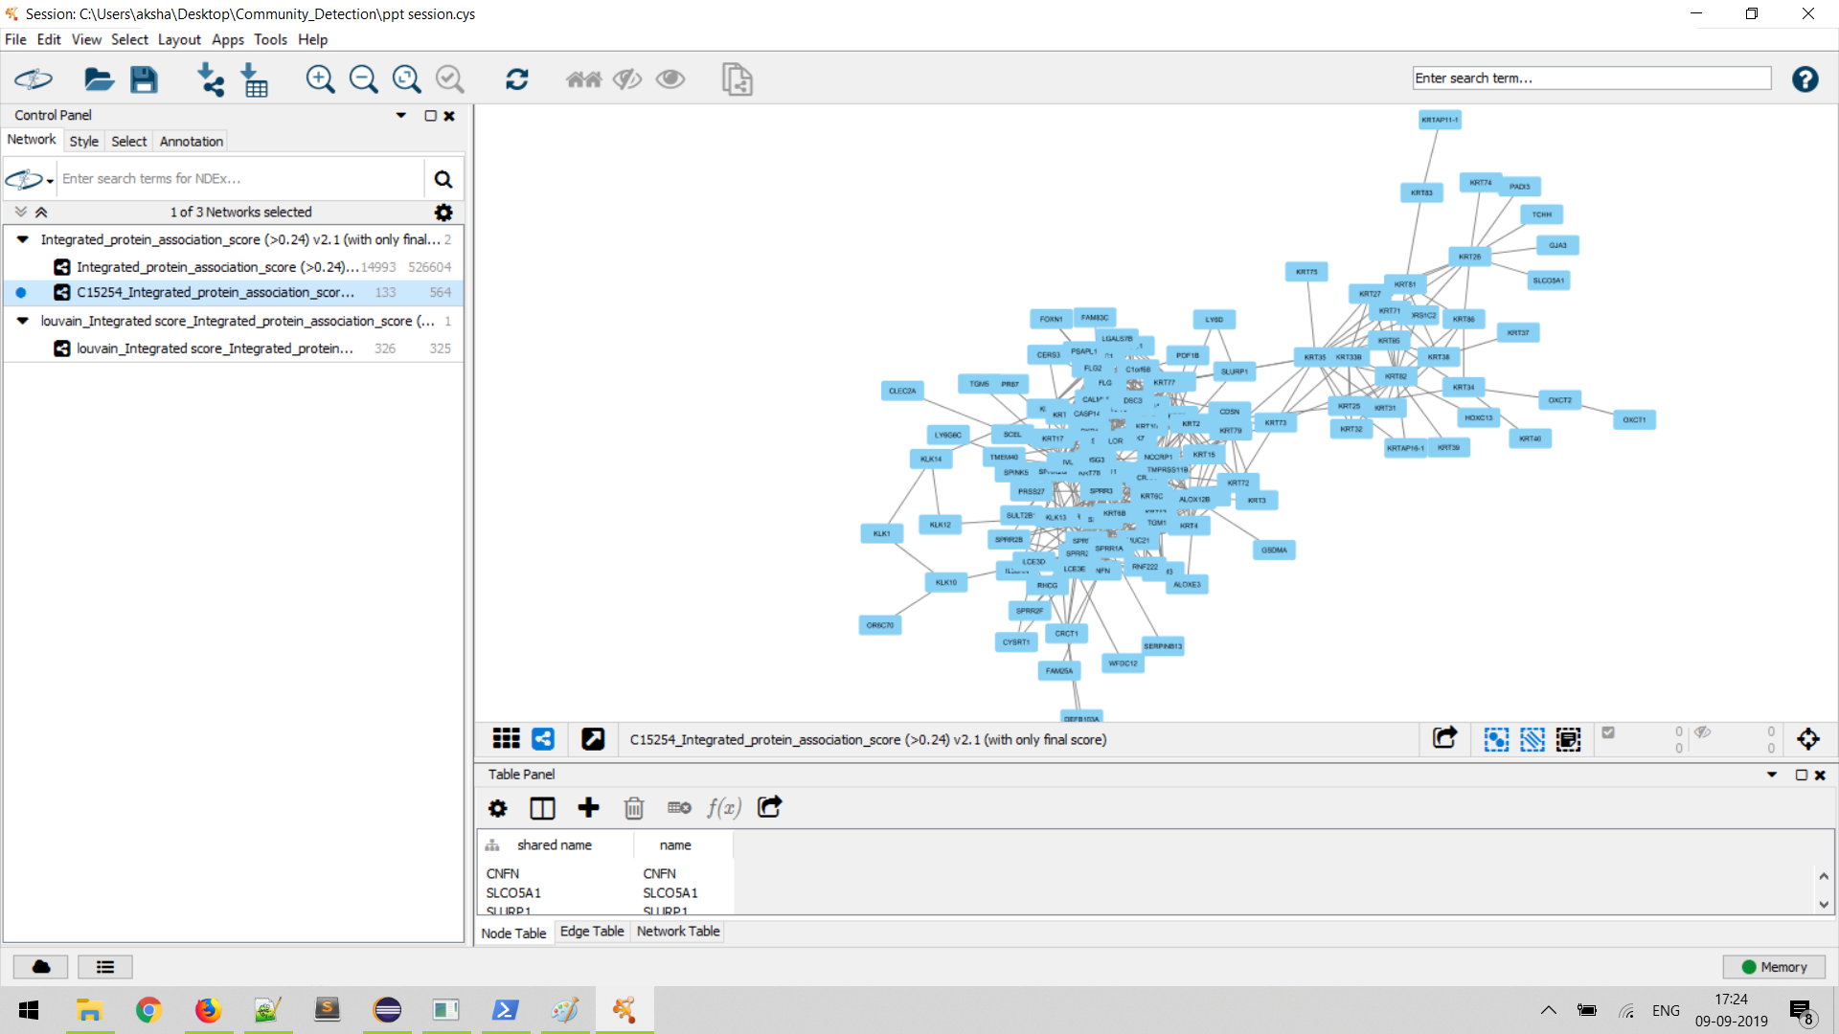
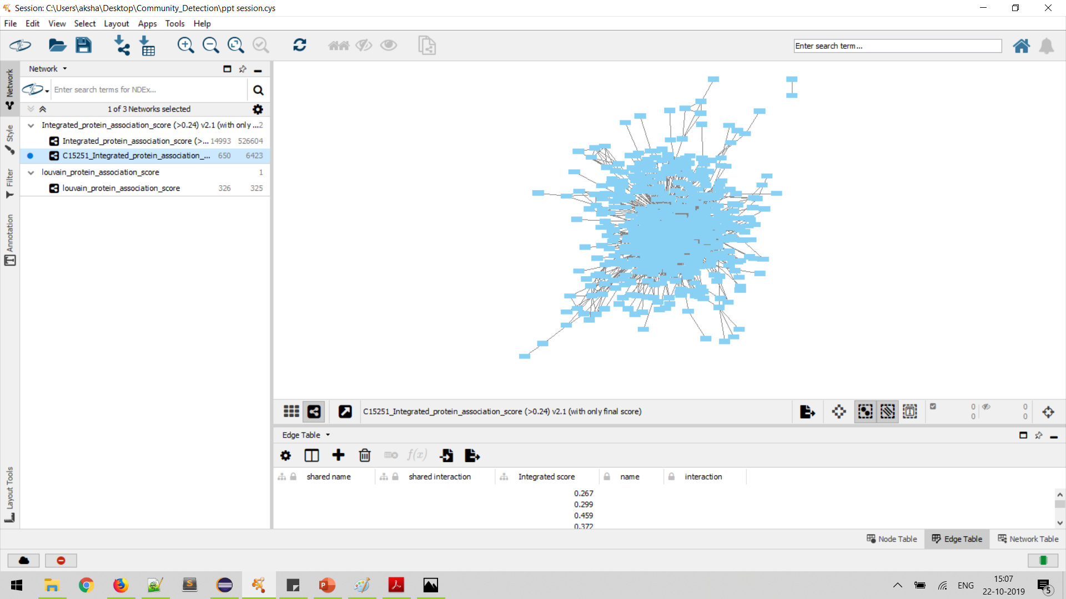

Slide 26
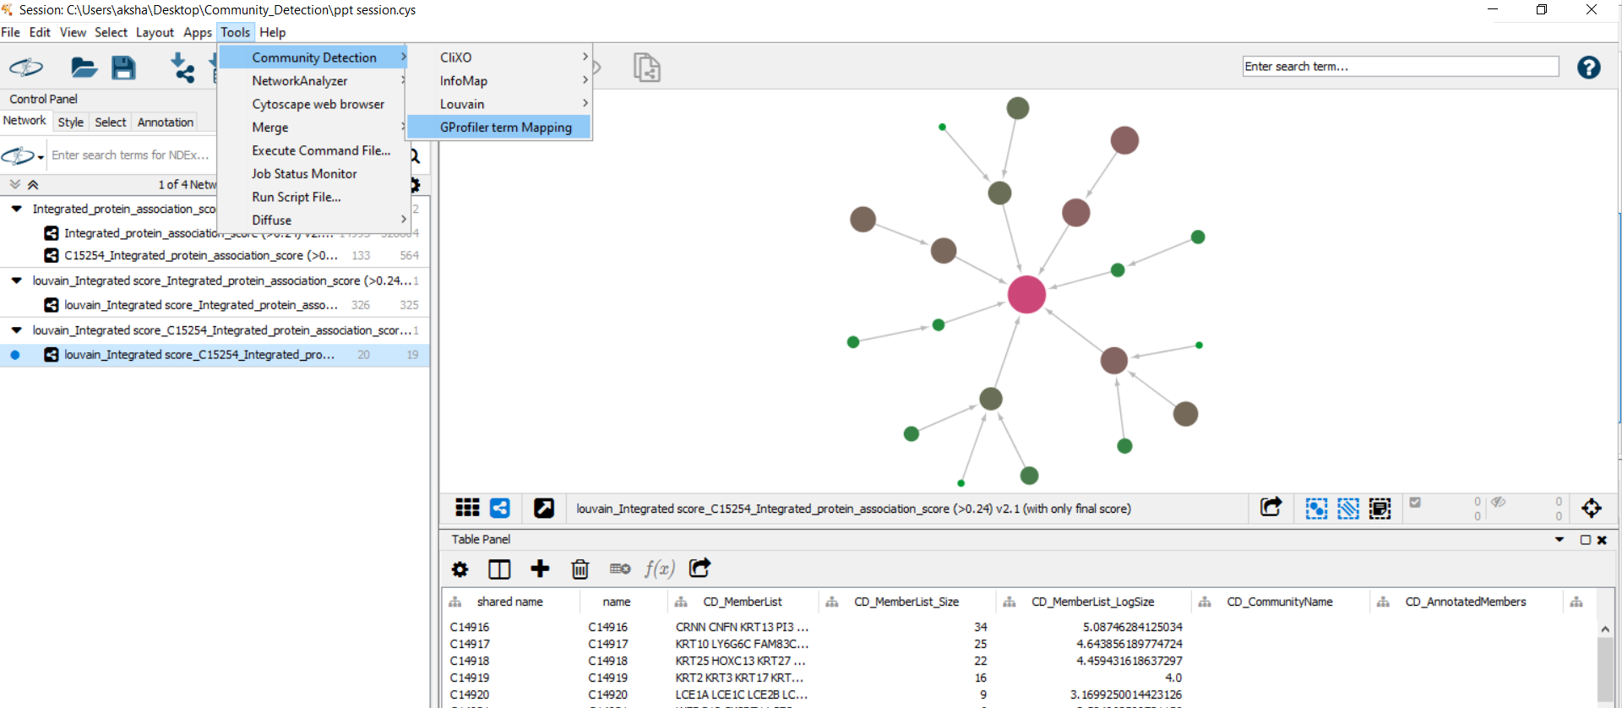
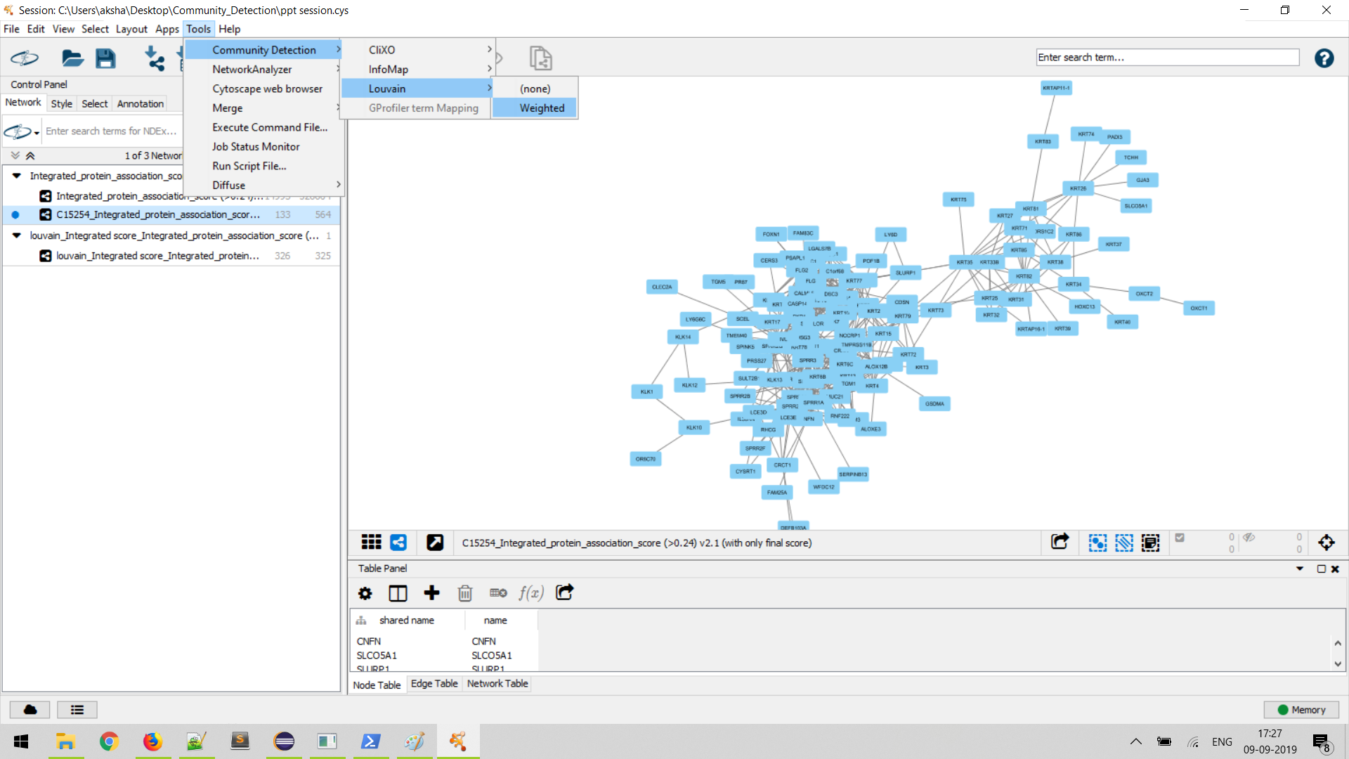
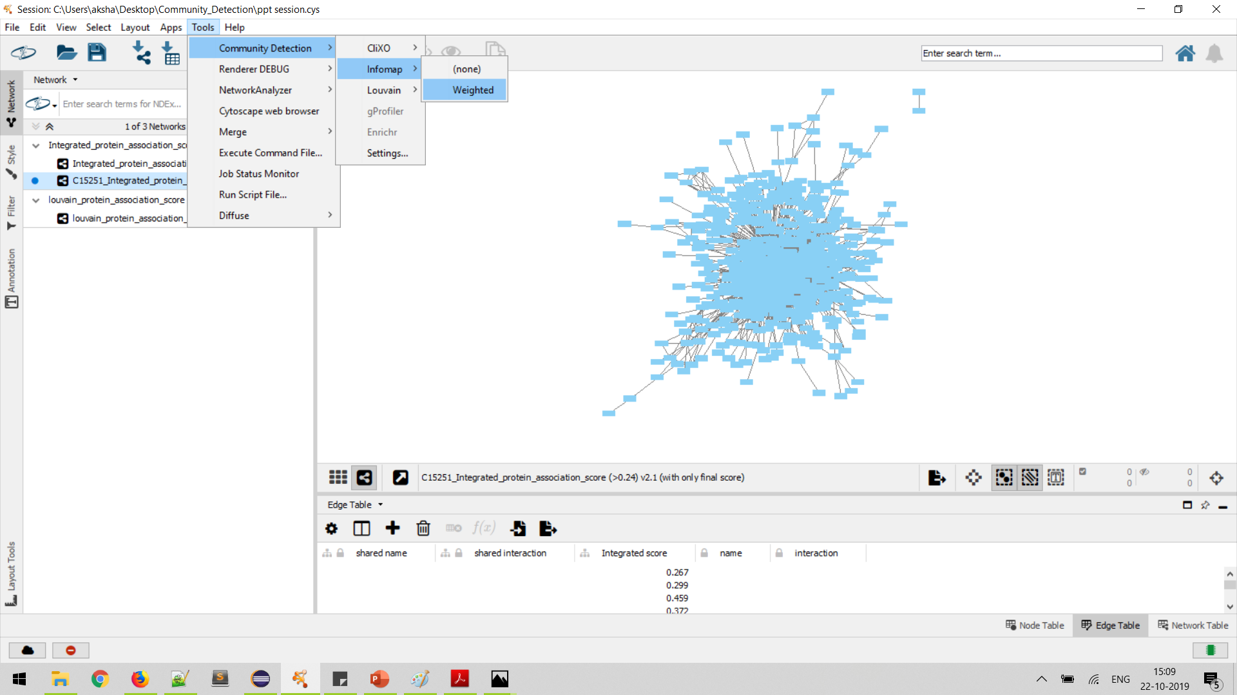

Slide 27
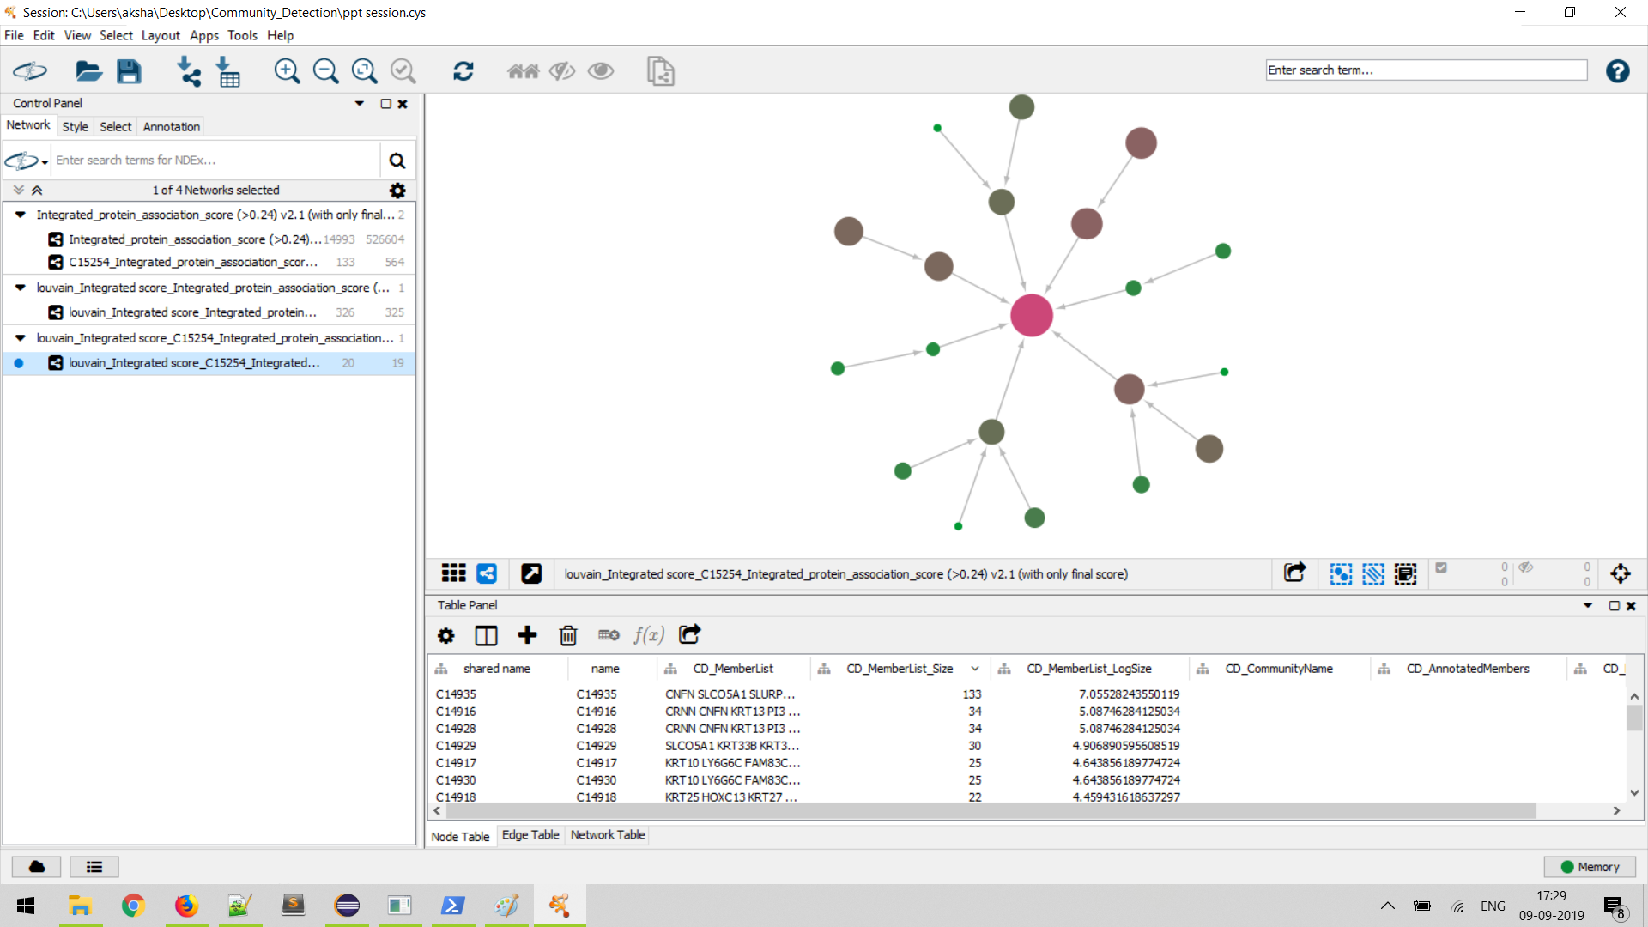

Slide 28
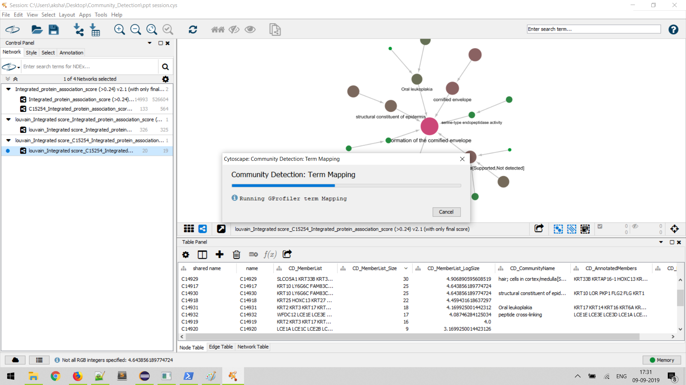

Slide 29
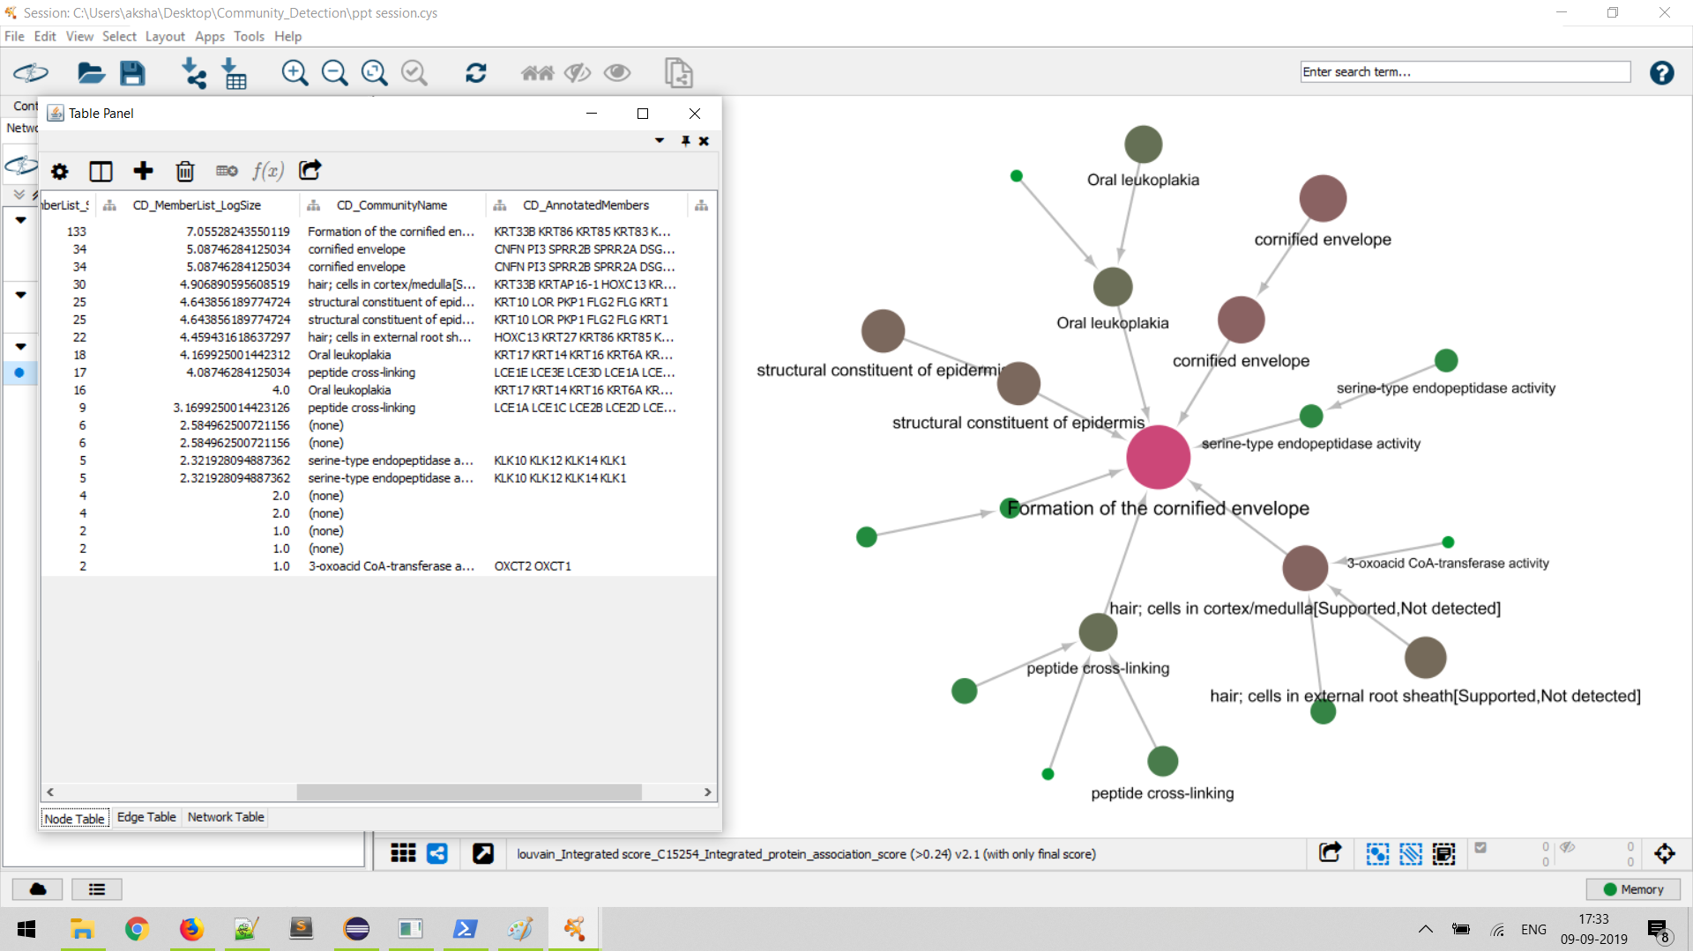

Slide 30
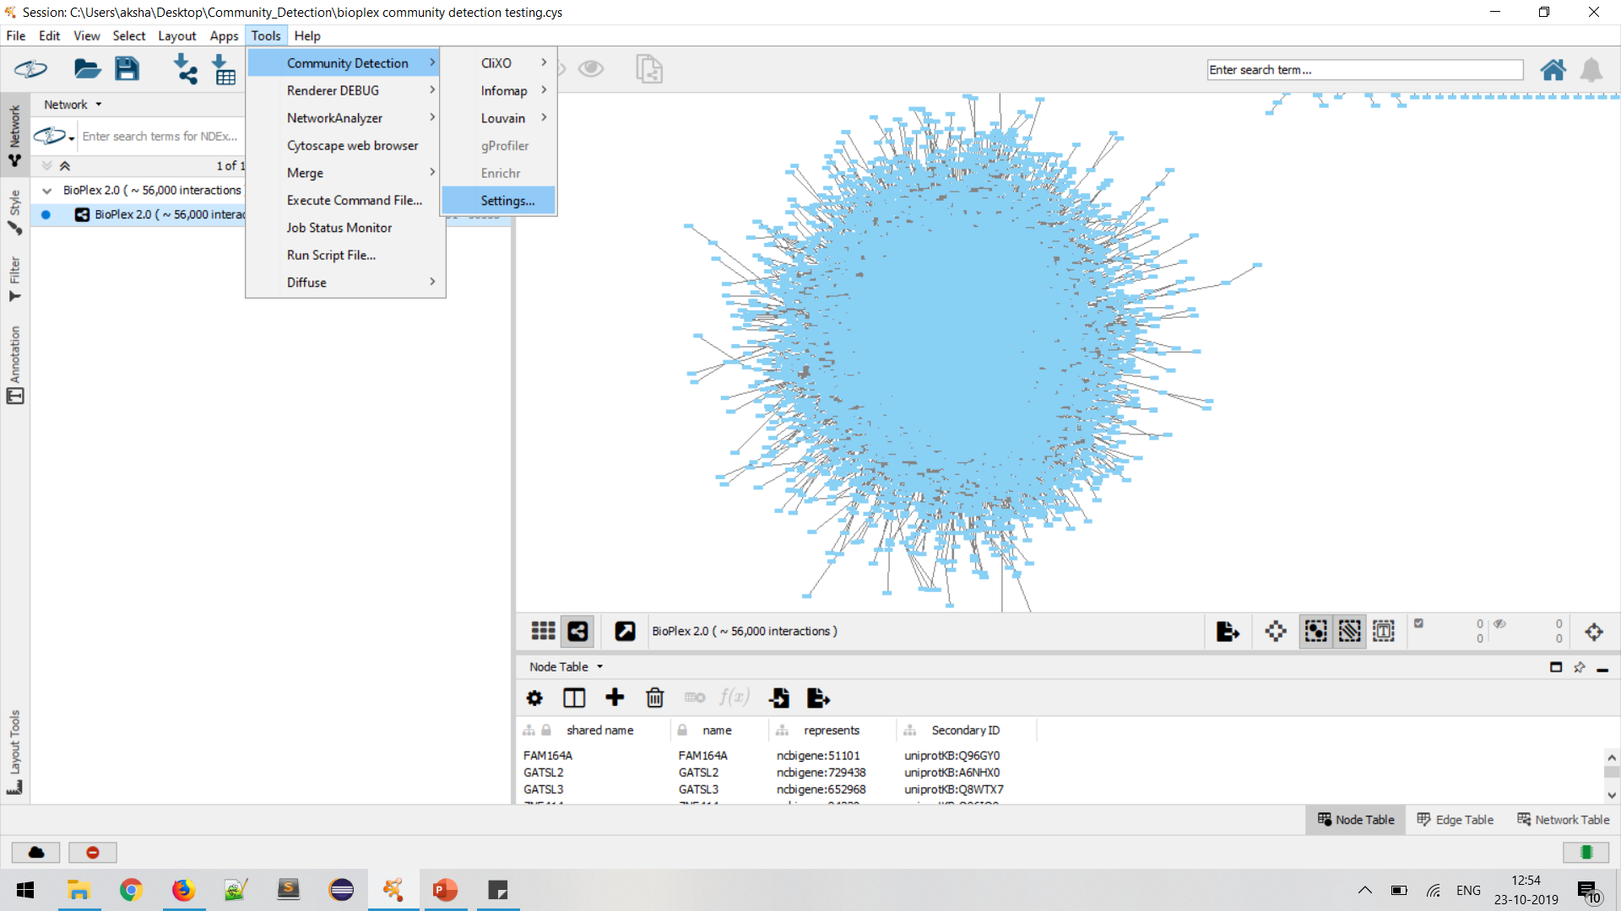

Slide 31
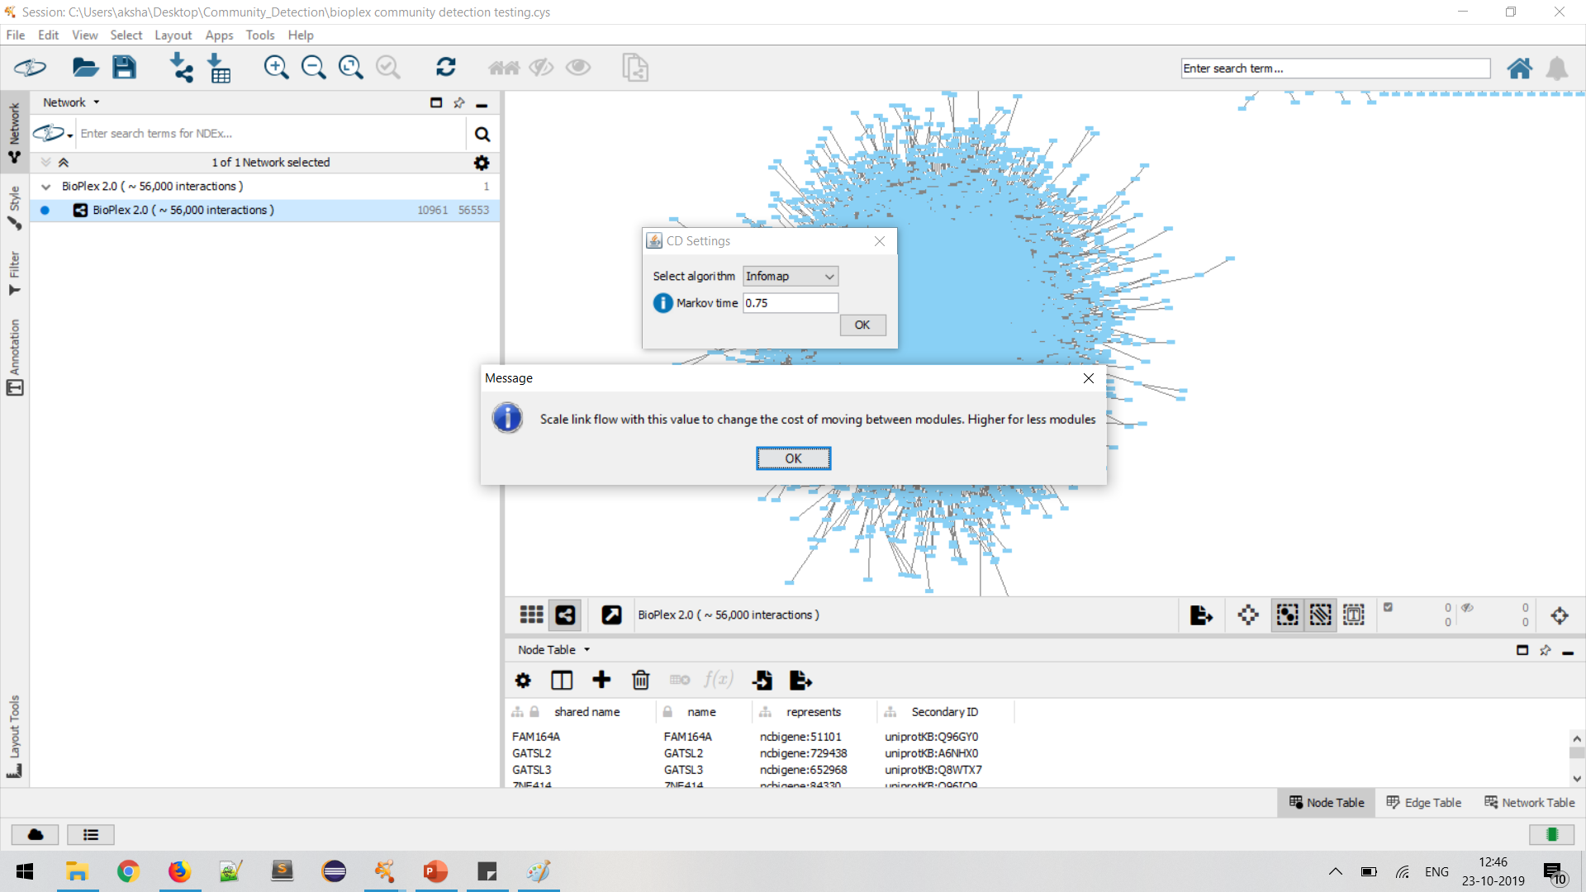

Slide 32
Future Work
Add more community detection algorithms, GO term alignment tools
Add layout algorithms as part of the suite
Help menu item to provide a brief overview of the algorithms

Slide 33
Feedback!

